Slide 1
Temperature Controller and IV Characterizer Group Number: DD 16 Project Guide: Prof. Joseph John
Group Members
OV Shashank 14D070021
Yogesh Mahajan 14D070022
Ayush Agrawal 14D070042

Slide 2
Abstract
The aim of the project was to build a wide range temperature controller using a Peltier Cooler
The set is to be used to plot the IV Characteristics of two terminal devices at various temperatures.
Along with the temperature controller, the IV Characteriser was also designed as part of the project.

Slide 3
Motivation
Not an easy way to quickly characterize a devices’ characteristic at various temperatures
Reduce the manual effort by designing an automated system
Learn about the Peltier Cooler
Learn precise low power system design for the IV Characteriser
Learn coding for new microprocessors and GUI Design

Slide 4
Sub-Systems
Peltier Temperature Controller
IV Characteriser
Power Supply Circuit
Microcontroller (TIVA-C Launchpad) and Python GUI

Slide 5
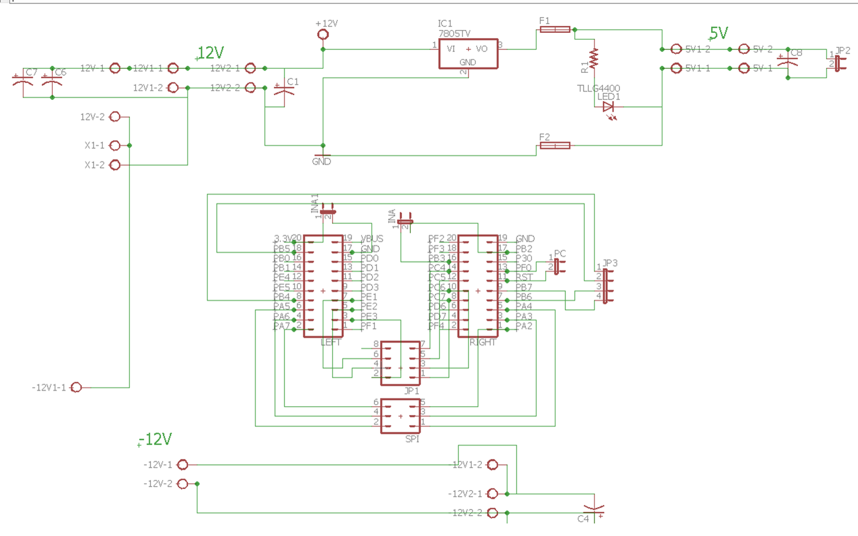
Power Supply Circuit and TIVA Breakout

Slide 6
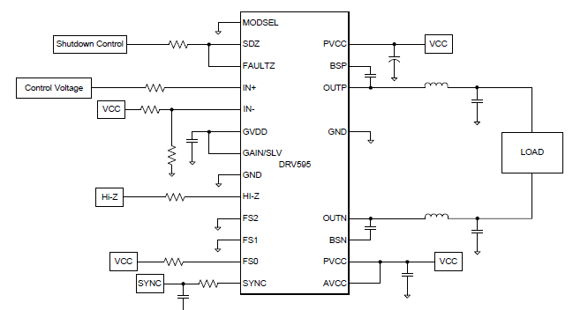
DRV595
H Bridge IC
High Power handling capability and internal direction switching
Testing Procedure
Problems Faced

Slide 7
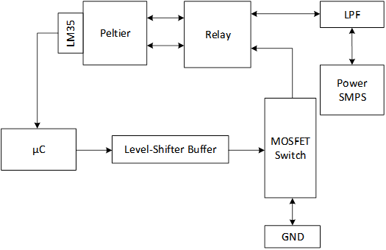
Peltier Temperature Controller

Slide 8
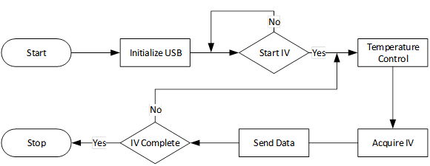
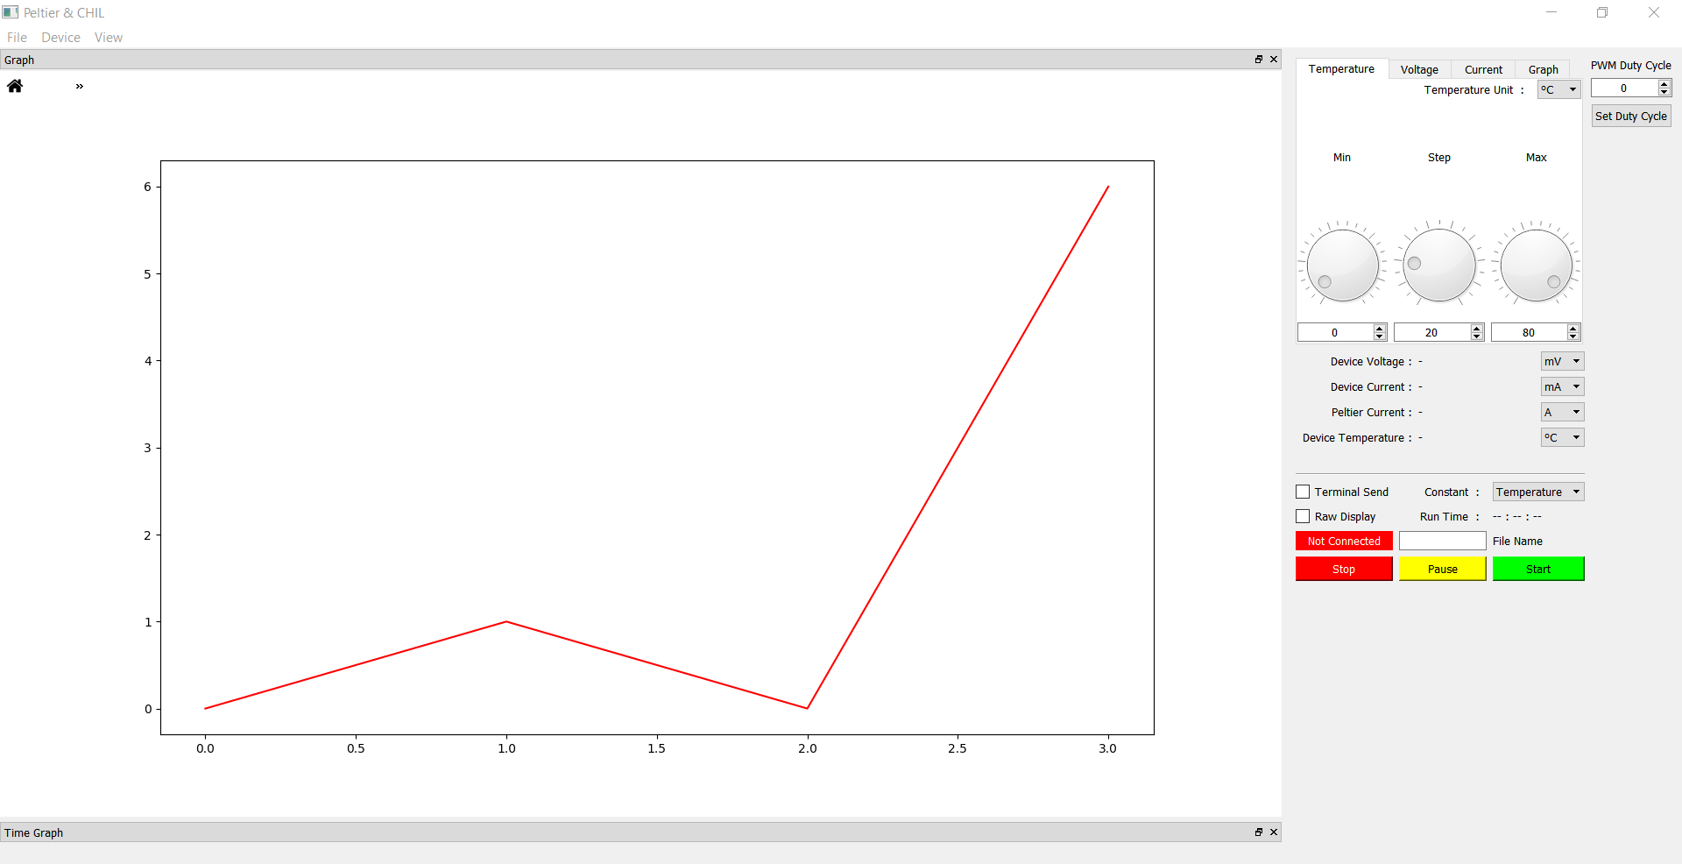
Tiva C and GUI

Slide 9
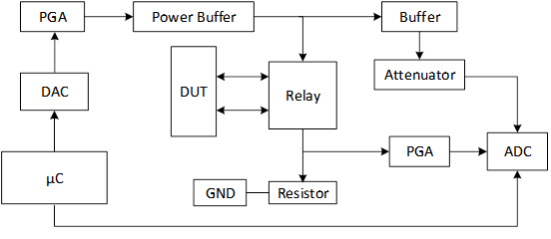
IV Characteriser

Slide 10
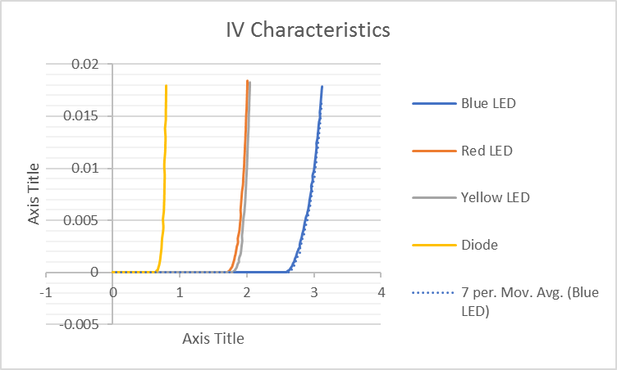
Testing Results
Peltier Temperatures were stabilised in the range of -5 degrees to 80 degrees
Temperatures around room temperatures showed more oscillations
IV Characterisation was completed and the following are the results

Slide 11
Demo Details
IV Characterisation for Diodes and Zener Diodes will be performed
A few temperatures will be shown to stabilise along with settling time details
Diode IV Characteristics will be plotted at a few set-point temperatures and the variation would be observed

Slide 12
Future Scope
Performing the small signal analysis of the two-terminal device
Extend support to multi-terminal devices by applying bias to the other terminals and performing the IV Characteristics across the remaining terminals
Temperature Control of the Peltier Cooler can be made more precise by using the double control loop
More dynamic changes can be introduced in the IV Characteristics to make the control more robust, immune to errors and fine grained to get high standard results.

